Slide 1
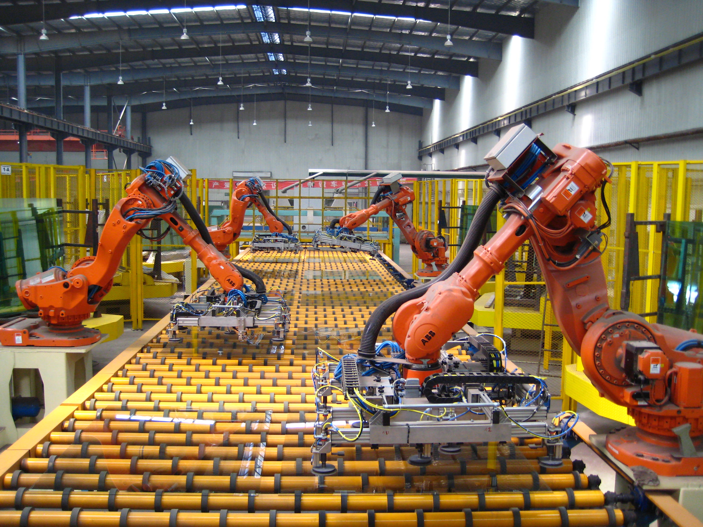

WEEK-8 + WEEK-9
Edge Hill University
Advanced Robotics and AI CIS3137
Dr. Ammar Al Mhdawi
Ammar.Al-Mhdawi@edgehill.ac.uk

Slide 2
Key to Success
Attendance
Pay attention to lectures and keep extra notes
Ask questions
Effort
Do homework on your own. It’s ok to ask others, but make your own effort
Read extra material on your own. Wealth of information available (library books, online articles, research papers)
Consistency
Keep up with the class pace

Slide 3
Class Expectations
Class participation – Your input is needed for good discussion
Keep up with reading material
Complete assignments and projects on time
Submit clean, organized, and concise CW reports

Slide 4
Contents
1
Python programming – important concepts
2
introduction to Webots simulation
3
Summary
4
Task

Slide 5

1
Python programming for robotics
Get a modern PowerPoint Presentation that is beautifully designed.
Why to learn Python?
Python is a general-purpose interpreted, interactive, object-oriented, and high-level programming language. It was created by Guido van Rossum during 1985- 1990
Python is designed to be highly readable. It uses English keywords frequently whereas other languages use punctuation, and it has fewer syntactical constructions than other languages.
Python is a MUST for students and working professionals specially in areas of robotics, web development, and application development.
It can be easily integrated with C, C++, COM, ActiveX, CORBA, and Java.
Easy-to-learn − Python has few keywords, simple structure, and a clearly defined syntax. This allows the student to pick up the language quickly.
Easy-to-read − Python code is more clearly defined and visible to the eyes.
GUI Programming − Python supports GUI applications that can be created and ported to many system calls, libraries and windows systems, such as Windows MFC, Macintosh, and the X Window system of Unix.

Slide 6
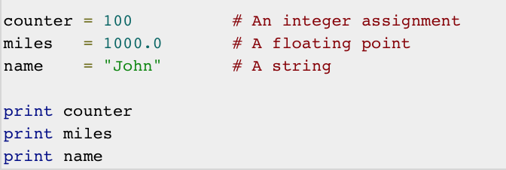
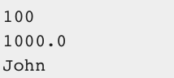
1
Python programming for robotics
Get a modern PowerPoint Presentation that is beautifully designed.
Variables
Python variables do not need explicit declaration to reserve memory space. The declaration happens automatically when you assign a value to a variable. The equal sign (=) is used to assign values to variables.
The operand to the left of the = operator is the name of the variable and the operand to the right of the = operator is the value stored in the variable.
Here, 100, 1000.0 and "John" are the values assigned to counter, miles, and name variables, respectively. This produces the following result →
syntax is very easy in python and not complicated as other programming languages.

Slide 7
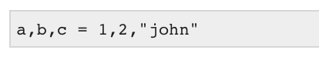
1
Python programming for robotics
Get a modern PowerPoint Presentation that is beautifully designed.
Variables
Python allows you to assign a single value to several variables simultaneously. For example :
Here, an integer object is created with the value 1, and all three variables are assigned to the same memory location. You can also assign multiple objects to multiple variables. For example :
Here, two integer objects with values 1 and 2 are assigned to variables a and b respectively, and one string object with the value "john" is assigned to the variable c.

Slide 8
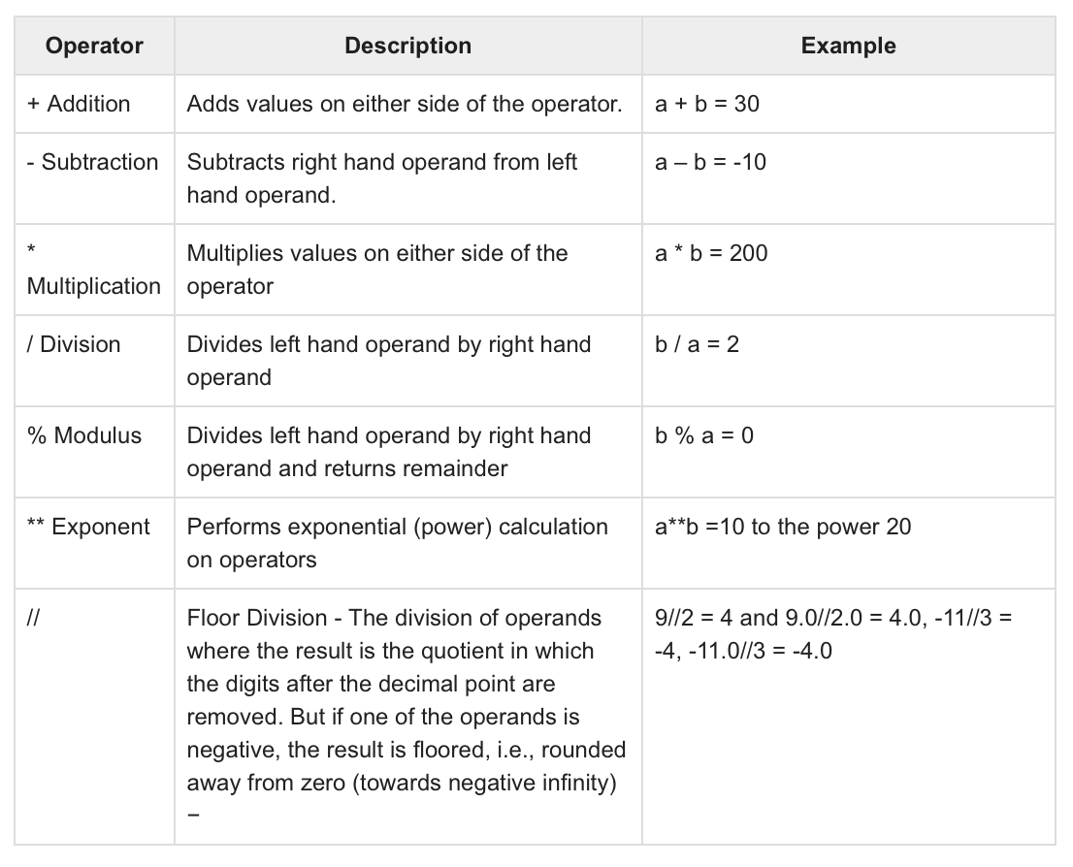
1
Python programming for robotics
Get a modern PowerPoint Presentation that is beautifully designed.
Operators
Python Arithmetic Operators

Slide 9
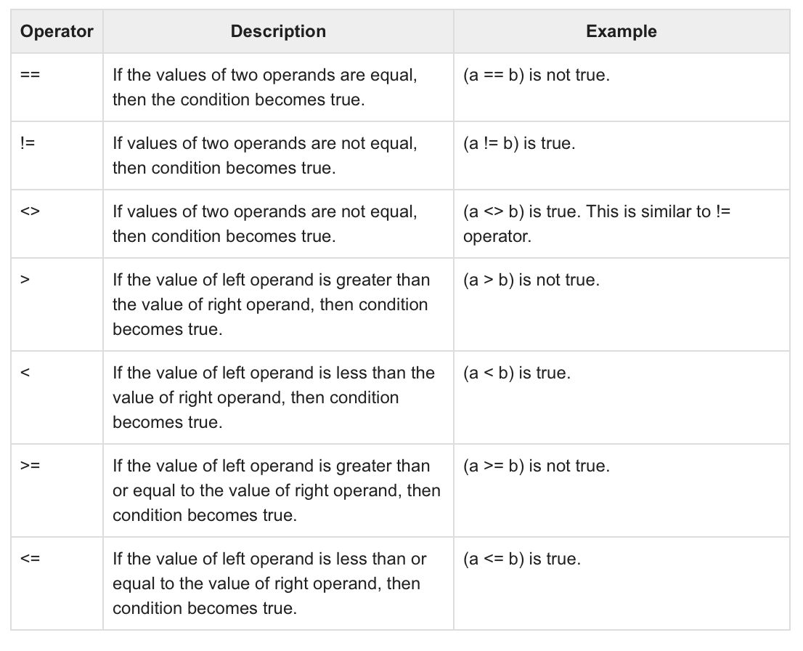
1
Python programming for robotics
Get a modern PowerPoint Presentation that is beautifully designed.
Operators
Python Comparison Operators

Slide 10
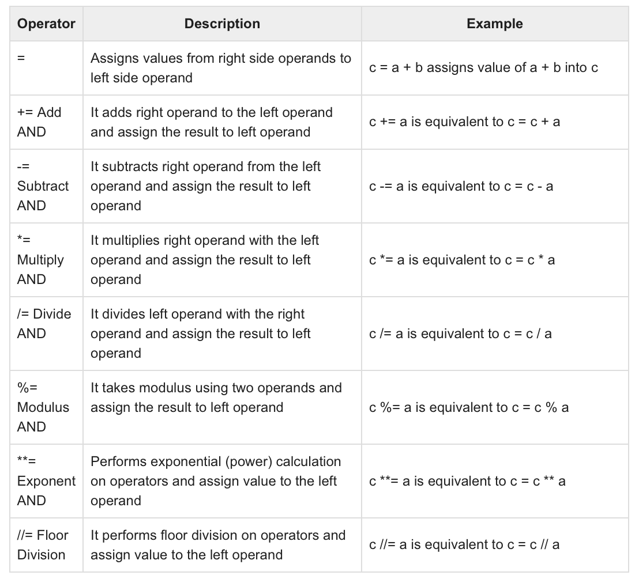
1
Python programming for robotics
Get a modern PowerPoint Presentation that is beautifully designed.
Operators
Python Assignment Operators

Slide 11
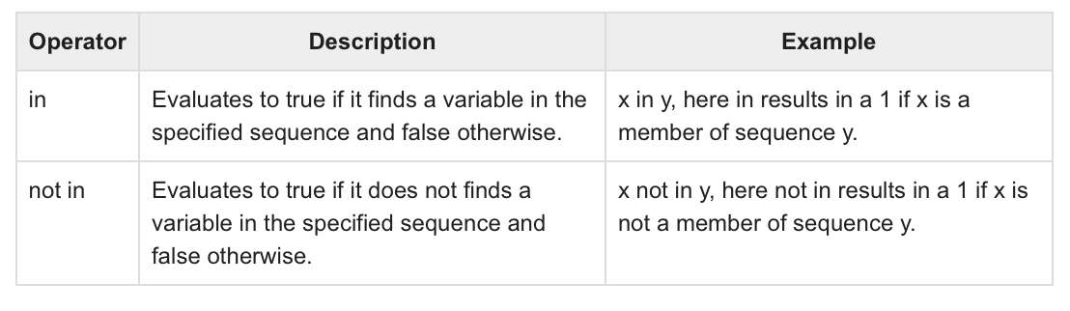
1
Python programming for robotics
Get a modern PowerPoint Presentation that is beautifully designed.
Operators
Python Membership Operators

Slide 12
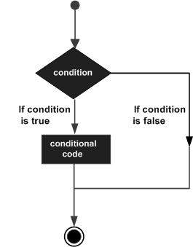
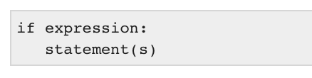
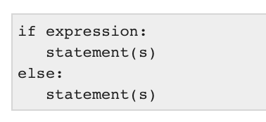
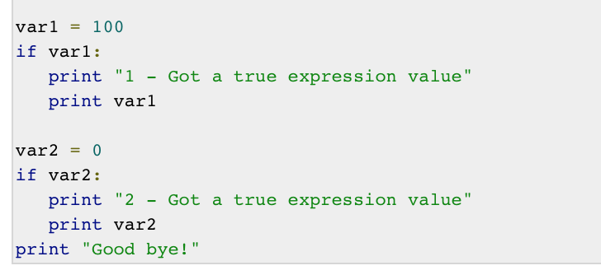
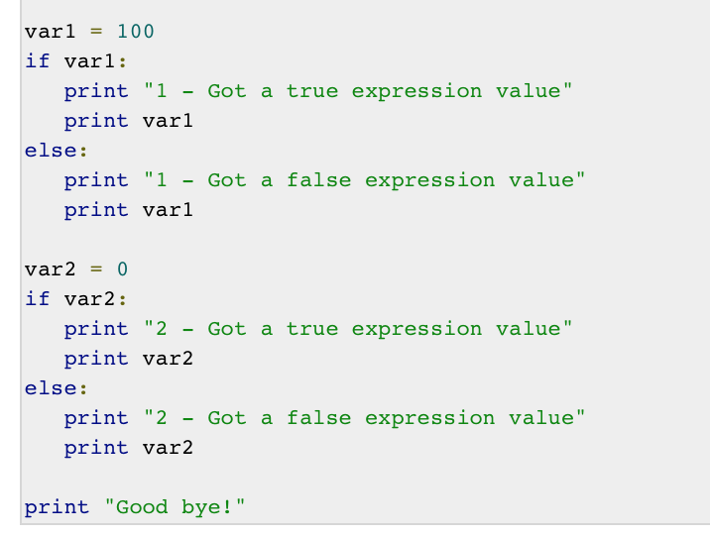
1
Python programming for robotics
Get a modern PowerPoint Presentation that is beautifully designed.
Decision Making
IF…ELSE : is a condition statement that produce TRUE or FALSE as outcome. You need to determine which action to take and which statements to execute if outcome is TRUE or FALSE otherwise.

Slide 13
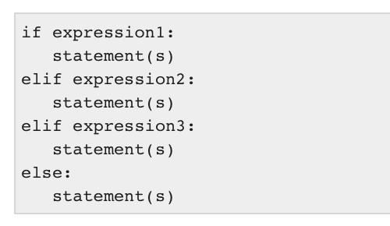
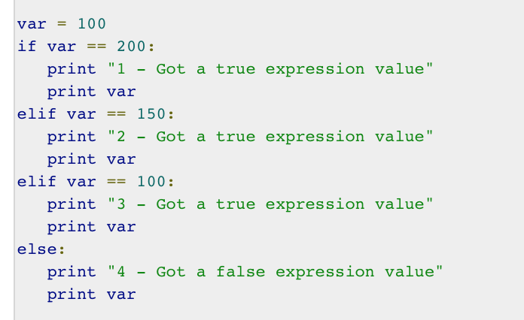
1
Python programming for robotics
Get a modern PowerPoint Presentation that is beautifully designed.
Decision Making
elif : is a statement that allows to check multiple expressions for TRUE and execute a block of code as soon as one of the conditions evaluates to TRUE.

Slide 14
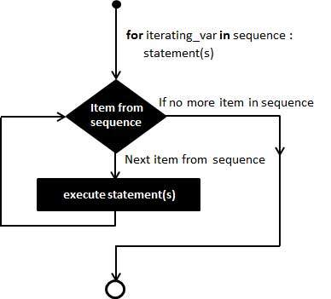
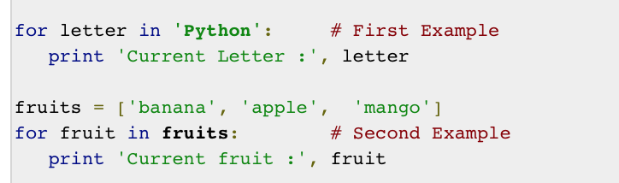
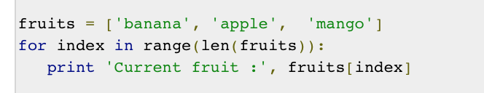
1
Python programming for robotics
Get a modern PowerPoint Presentation that is beautifully designed.
Loops
A loop statement allows us to execute a statement or group of statements multiple times. The following diagram illustrates a loop statement −

Slide 15
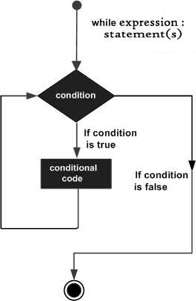
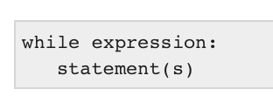
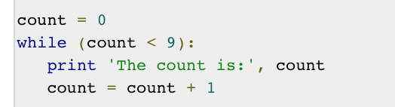
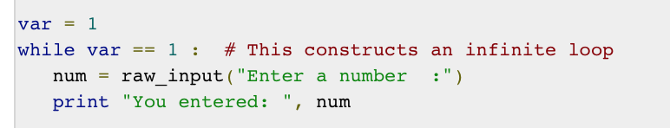
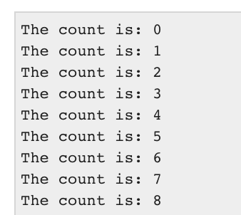
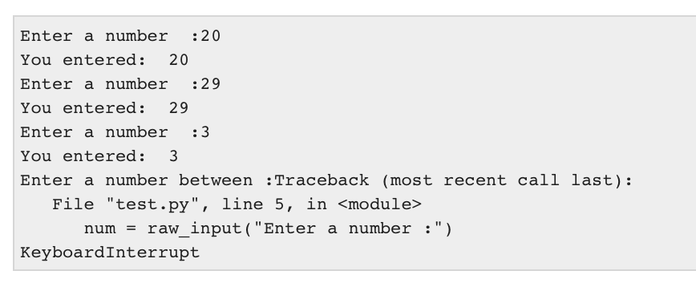
1
Python programming for robotics
Get a modern PowerPoint Presentation that is beautifully designed.
Loops
A while loop statement in Python programming language repeatedly executes a target statement as long as a given condition is true.
The infinite loop
A loop becomes infinite loop if a condition never becomes FALSE

Slide 16
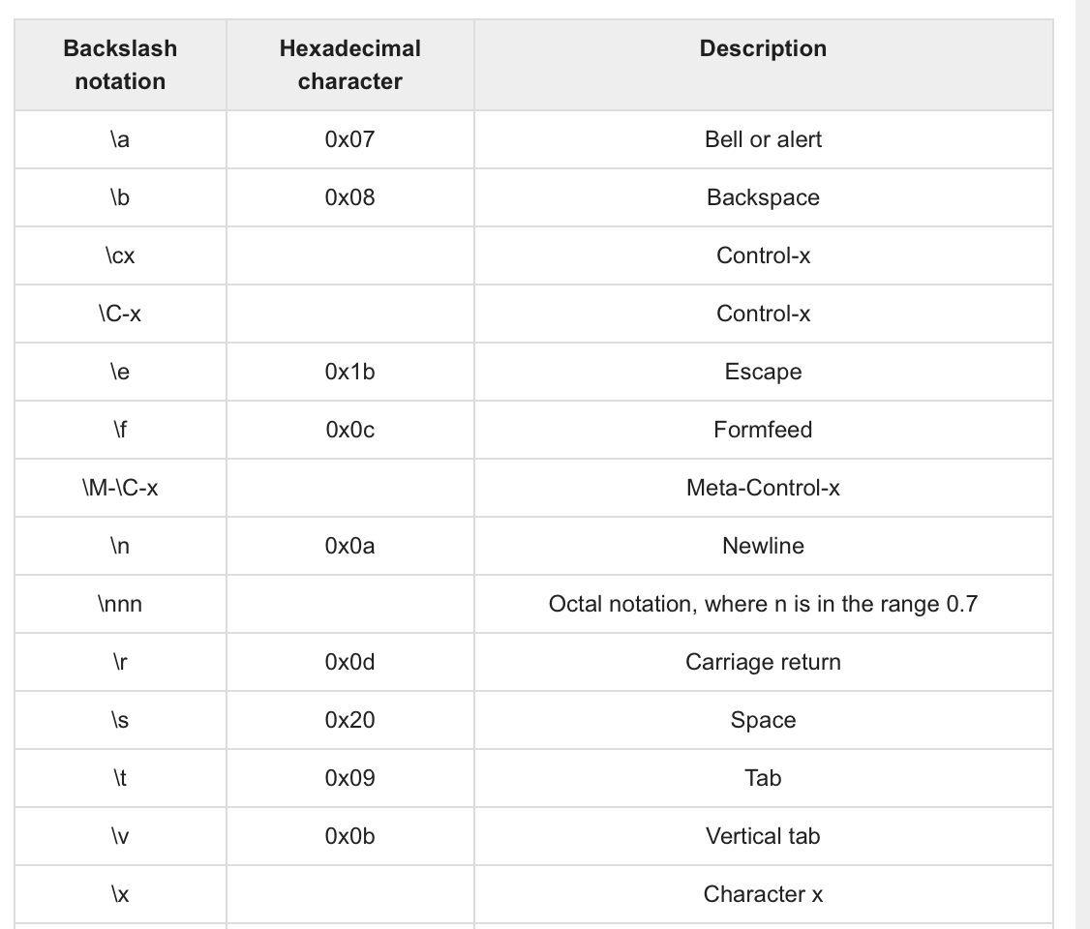
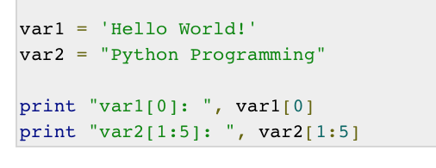
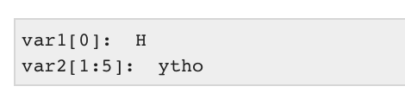
1
Python programming for robotics
Get a modern PowerPoint Presentation that is beautifully designed.
Strings
Python does not support a character type; these are treated as strings of length one, thus also considered a substring.
To access substrings, use the square brackets for slicing along with the index or indices to obtain your substring. For example −

Slide 17
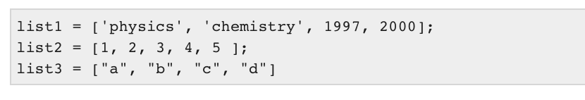
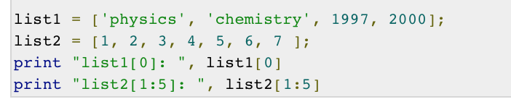
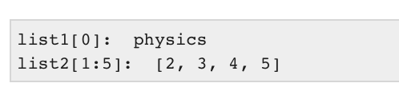
1
Python programming for robotics
Get a modern PowerPoint Presentation that is beautifully designed.
Lists
The list is a most important datatype available in Python which can be written as a list of comma-separated values (items) between square brackets. Important thing about a list is that items in a list need not be of the same type.
Creating a list is as simple as putting different comma-separated values between square brackets. For example −
To access values in lists, use the square brackets for slicing along with the index or indices to obtain value available at that index. For example :

Slide 18
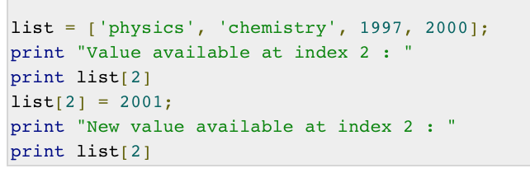
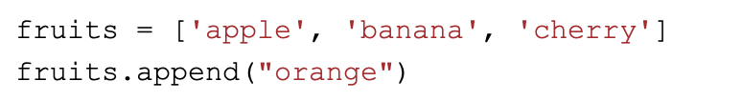
1
Python programming for robotics
Get a modern PowerPoint Presentation that is beautifully designed.
Lists
You can update single or multiple elements of lists by giving the slice on the left-hand side of the assignment operator, or you can add to elements in a list with the append() method which is more convenient. For example −
direct entry change with the (=) operation
change with append() method
the appended item will be added to the last index of the list

Slide 19
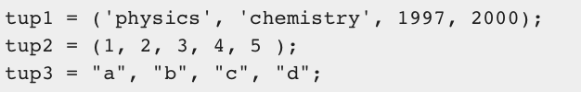
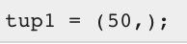
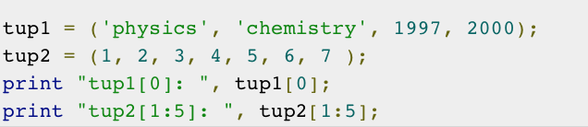
1
Python programming for robotics
Get a modern PowerPoint Presentation that is beautifully designed.
Tuples
Tuples are sequences, just like lists. The differences between tuples and lists are, the tuples cannot be changed unlike lists and tuples use parentheses, whereas lists use square brackets.
To write a tuple containing a single value you have to include a comma, even though there is only one value :
To access values in tuple, use the square brackets for slicing along with the index or indices to obtain value available at that index. For example :

Slide 20
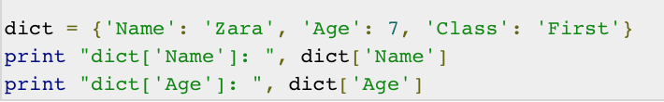
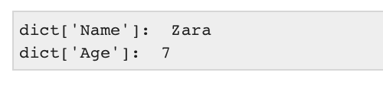
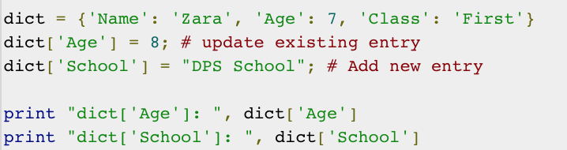
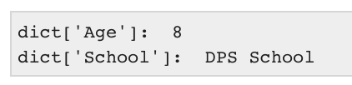
1
Python programming for robotics
Get a modern PowerPoint Presentation that is beautifully designed.
Dictionary
Each key is separated from its value by a colon (:), the items are separated by commas, and the whole thing is enclosed in curly braces
Keys are unique within a dictionary while values may not be. The values of a dictionary can be of any type, but the keys must be of an immutable data type such as strings, numbers, or tuples.
You can update a dictionary by adding a new entry or a key-value pair, modifying an existing entry, or deleting an existing entry as shown below in the simple example −

Slide 21
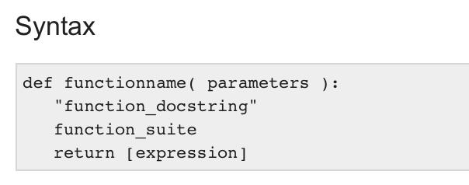
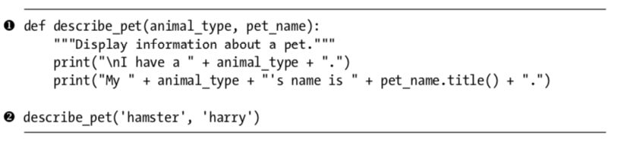
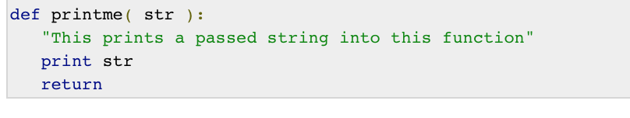
1
Python programming for robotics
Get a modern PowerPoint Presentation that is beautifully designed.
Functions
A function is a block of organized, reusable code that is used to perform a single, related action
some examples of functions taking specific input and process it.

Slide 22
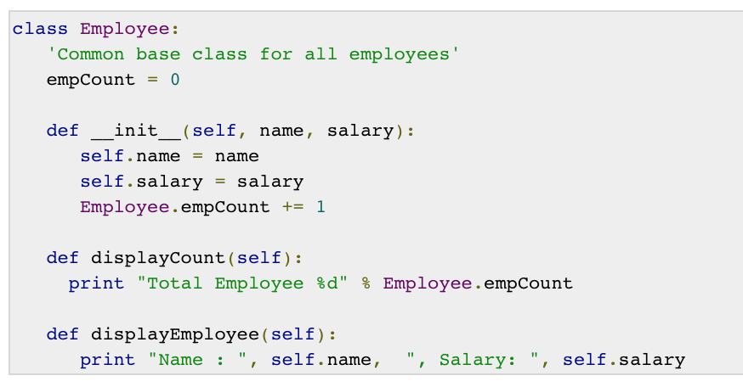
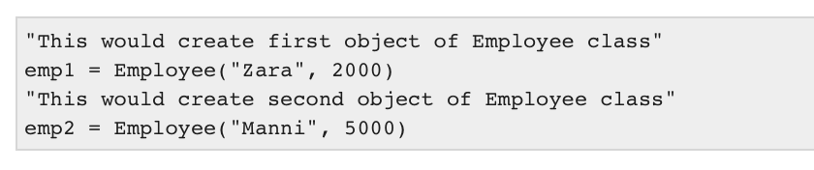
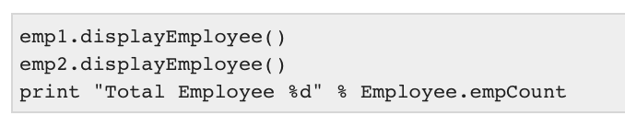
1
Python programming for robotics
Get a modern PowerPoint Presentation that is beautifully designed.
Class
A user-defined prototype for an object that defines a set of attributes that characterize any object of the class. The attributes are data members (class variables and instance variables) and methods, accessed via dot notation.
Class variable − A variable that is shared by all instances of a class. Class variables are defined within a class but outside any of the class's methods. Class variables are not used as frequently as instance variables are.
The first method __init__() is a special method, which is called class constructor or initialization method that Python calls when you create a new instance of this class.
To create instances of a class, you call the class using class name and pass in whatever arguments its __init__ method accepts.
You access the object's attributes using the dot operator with object. Class variable would be accessed using class name as follows −

Slide 23
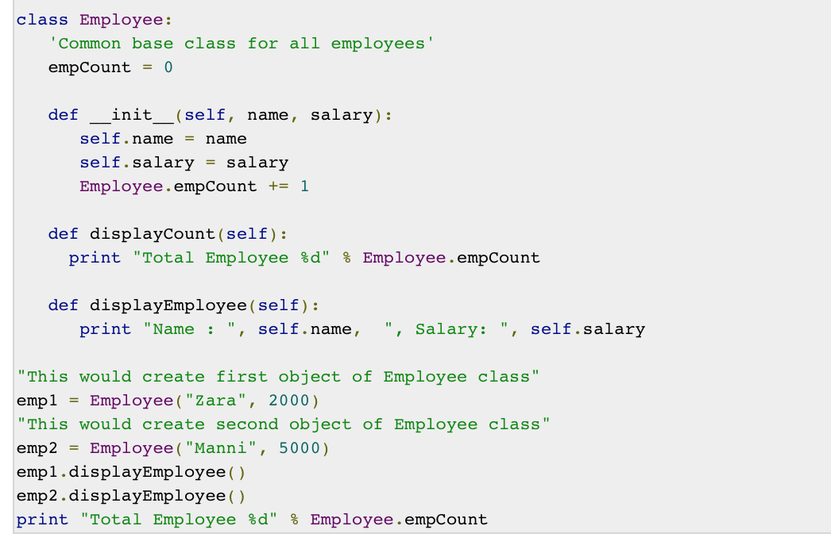
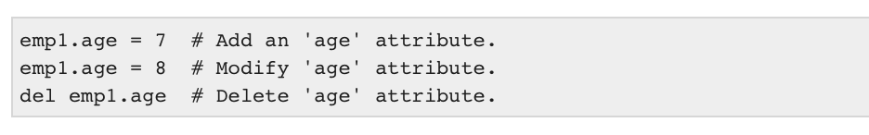
1
Python programming for robotics
Get a modern PowerPoint Presentation that is beautifully designed.
Class
Putting the entire code together
You can add, remove, or modify attributes of classes and objects at any time −

Slide 24
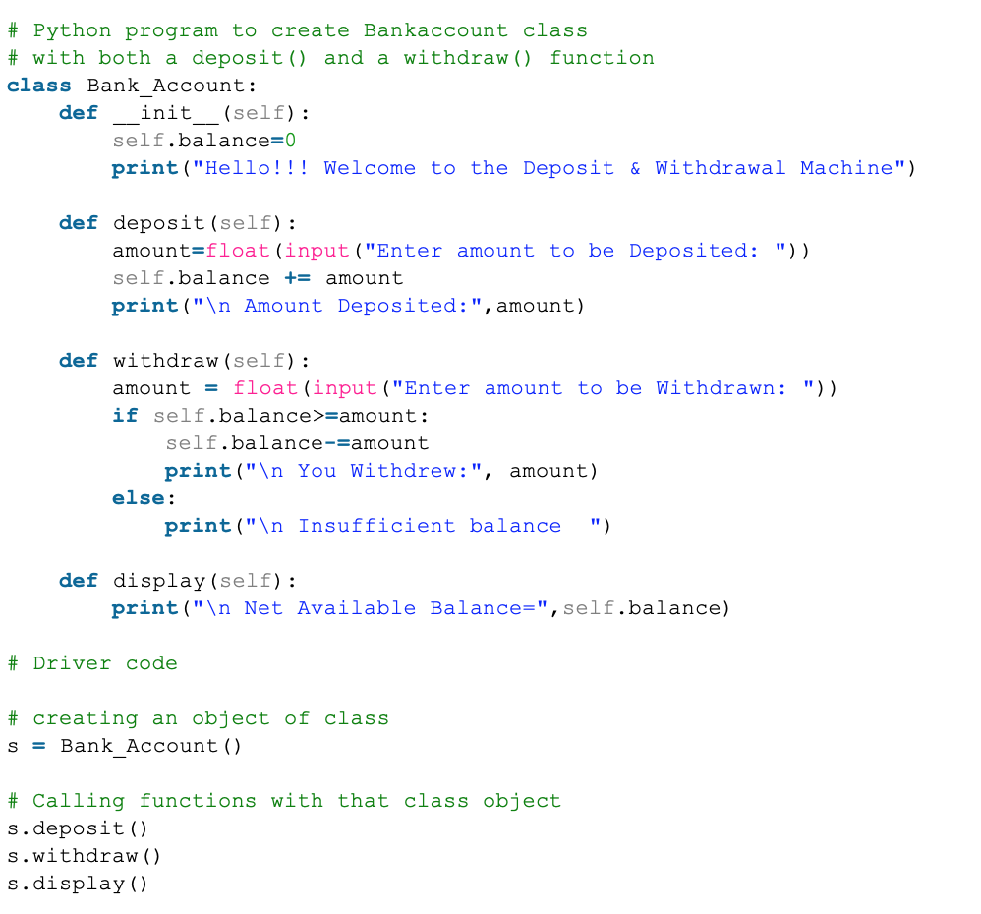
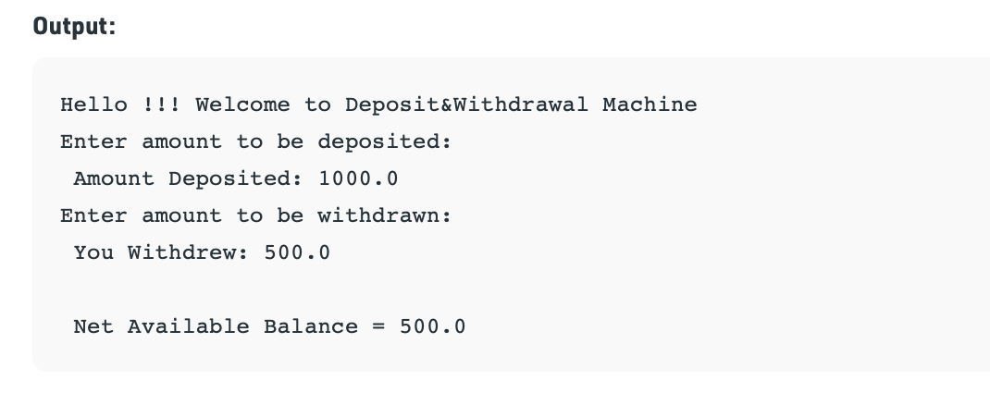
1
Python programming for robotics
Get a modern PowerPoint Presentation that is beautifully designed.
Class
An example of creating bank account class with deposit and withdraw functions

Slide 25
1
Python programming for robotics
Get a modern PowerPoint Presentation that is beautifully designed.
Task-1:
Develop a program that define a “RobotManipulator” class. The robot initial values are ID, HW_type, purpose, login_pw, no_of_joints, age, charge_value, charge_drop. The RobotProtype class must have the following methods: print_ID(), get_joints(), add_joints(), check_btry_level()
1- create 5 robot objects with different details
2- print the details of each robot in an organized detailed format
3- calculate the charge level of robot #3 after 2.5hrs of operation
4- add 2 new joints to robot #4 and display the old and new joints values
NOTE: the charge drop is 3.1 every 1 hr of operation
Task-2:
Develop a program that define a robot vehicle class “RoboVic”. The robot must be initiated with brand, model, type, gas tank size, and fuel level.
1- create 2 robot vehicles with different details
2- print the details of each vic in an organized detailed format
3- check the fuel level tank after driving. The vic consume 0.75 lit per 2 miles.
4- add fuel and check the new fuel tank level

Slide 26
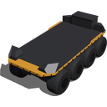










2
introduction to Webots simulation
Get a modern PowerPoint Presentation that is beautifully designed.
Webots Overview
Webots is an open-source under the Apache 2.0 license. three-dimensional mobile robot simulator.
It was originally developed as a research tool to investigate various control algorithms in mobile robotics
It support development of various types of robots from design to full control and simulation
Webots support the development of commercial and research robots
Supported robots: https://cyberbotics.com/doc/guide/robots?tab-language=python

Slide 27
2
introduction to Webots simulation
Get a modern PowerPoint Presentation that is beautifully designed.
System requirements
A recent PC or Mac computer with at least a 2 GHz dual core CPU clock speed and 2 GB of RAM is a minimum requirement. A quad-core CPU is however recommended.
An NVIDIA or AMD OpenGL (minimum version 3.3) capable graphics adapter with at least 512 MB of RAM is required
The following operating systems are supported:
Linux: Webots is ensured to run on the latest Ubuntu Long Term Support (LTS) release, currently version 20.04.
Windows: Webots runs on Windows 10 and Windows 8.1 (64-bit versions only).
Mac: Webots runs on macOS 10.15 "Catalina" and 10.14 "Mojave".
Pre-installation guide : https://cyberbotics.com/doc/guide/installation-procedure?tab-language=python
Post-installation guide: https://cyberbotics.com/doc/guide/starting-webots?tab-language=python
Webots is released under the terms of the Apache 2.0 license agreement. Apache 2.0 is an industry friendly, non-contaminating, permissive open-source license that grants everyone the right to use a software source code, free of charge, for any purpose, including commercial applications.
License agreement : https://cyberbotics.com/doc/guide/webots-license-agreement?tab-language=python
Privacy policy: https://cyberbotics.com/doc/guide/privacy-policy?tab-language=python

Slide 28
2
introduction to Webots simulation
Get a modern PowerPoint Presentation that is beautifully designed.
Benefits of Webots
It offers a rapid prototyping environment, that allows the user to create 3D virtual worlds with physics properties such as mass, joints, friction coefficients, etc
Support different types of sensors and actuators such as cameras, motors, sensors, receivers.
Adaptive behaviour research (genetic algorithm, neural networks, AI, etc.)
Multi-agent research such as swarm intelligence
Supported programming languages and files
A basic knowledge of the C, C++, Java, Python or MATLAB programming language is necessary to program your own robot controllers ( for this course, we will use Python only).
A Webots world file (.wbt) that defines one or several robots and their environment. The .wbt file does sometimes depend on external PROTO files (.proto) and textures.
A world, in Webots, is a 3D description of the properties of robots and of their environment. It contains a description of every object: position, orientation, geometry, appearance (like colour or brightness), physical properties, type of object, etc.
A controller is a computer program that controls a robot specified in a world file. Controllers can be written in any of the programming languages supported by Webots: C, C++, Java, Python or MATLAB. When a simulation starts, Webots launches the specified controllers, each as a separate process, and it associates the controller processes with the simulated robots

Slide 29

2
introduction to Webots simulation
Get a modern PowerPoint Presentation that is beautifully designed.
The user interface
Webots GUI is composed of four principal windows:
The 3D window that displays and allows you to interact with the 3D simulation.
The Scene tree which is a hierarchical representation of the current world.
The Text editor that allows you to edit source code.
The Console that displays both compilation and controller outputs.
2
1
3
4
Tool bar and menu index: https://cyberbotics.com/doc/guide/the-user-interface?tab-language=python

Slide 30




2
introduction to Webots simulation
Get a modern PowerPoint Presentation that is beautifully designed.
3D window
A single mouse left click allows you to select a Solid object. The bounding object of a selected solid is represented by white lines. These lines turn pink if the solid is colliding with another one and blue when the solid is idle, i.e., it comes to rest and it does not interact with any other active solid
Dragging the mouse while pressing a mouse button moves the camera of the 3D window.
When a solid object is selected, some arrow-shaped handles appear in the 3D window. These handles can be used to translate and rotate the object along the corresponding axis. For moving the object you can simply click on the handle and drag it to the desired position. A label will show the current relative translation or rotation during the movement.

Slide 31

2
introduction to Webots simulation
Get a modern PowerPoint Presentation that is beautifully designed.
Language setup - Python
Refer to this link to setup the python option for programming in Webots according to your computer system:
https://cyberbotics.com/doc/guide/using-python?tab-language=python

Slide 32

2
introduction to Webots simulation
Get a modern PowerPoint Presentation that is beautifully designed.
Example 1: first simulation
The objective of this first tutorial is to familiarize yourself with the user interface and with the basic concepts of Webots.
You will create your first simulation containing a simple environment: an arena with floor and walls, a few boxes, an e-puck robot and a controller program that will make the robot move.
Start Webots by double-clicking on its icon (or invoking it from a command line in a Terminal).
Create a new project from the Wizards menu by selecting the New Project Directory... menu item and follow the instructions:
Name the project directory my_first_simulation instead of the proposed my_project.
Name the world file my_first_simulation.wbt instead of the proposed empty.wbt.
Click all the tick boxes, including the "Add a rectangle arena" which is not ticked by default.

Slide 33
2
introduction to Webots simulation
Get a modern PowerPoint Presentation that is beautifully designed.
Example 1: first simulation
Double-click on the RectangleArena node in the scene tree. This should open the node and display its fields.
Select the floorTileSize field and set its value to 0.25 0.25 instead of 0.5 0.5. You should see the effect immediately in the 3D view.
Select the wallHeight field and change its value to 0.05 instead of 0.1. The wall of the arena should now be lower.
4. Double-click on the RectangleArena in the scene tree to close it and select it. Click on the Add button + at the top of the scene tree
5. In the open dialog box, choose PROTO nodes (Webots Projects). A big box should appear in the middle of the arena. Double-click on it in the scene tree to open its fields.
Change its size to 0.1 0.1 0.1 instead of 0.6 0.6 0.6.
Change its translation to 0 0.05 0 instead of 0 0.3 0. Alternatively, you may use the green arrow that appears in the 3D view to adjust its translation.y field.
Now shift-click and drag the box in the 3D view and move it in some corner of the arena.

Slide 34

2
introduction to Webots simulation
Get a modern PowerPoint Presentation that is beautifully designed.
Example 1: first simulation (Continued)
5. Select the box and press Ctrl+C, Ctrl+v to copy and paste it. Shift-click and drag the new box to move it at some different location. Create a third box this way.
6. Move the boxes, so that no box is at the centre of the arena. You may also use the green rotation arrows to rotate the boxes along the vertical axis. This can be done also by shift-click and drag with the right mouse button. Alternatively, you can change the angle of the rotation field of the WoodenBox nodes in the scene tree.
7. Once you are satisfied with the result, save the world using the save button.
Adding an e-puck robot
The e-puck is a small robot having differential wheels, 10 LEDs, and several sensors including 8 DistanceSensors and a Camera. In this tutorial we are only interested in using its wheels
Click on the Add button + at the top of the scene tree view.
In the dialog box, choose PROTO nodes
An e-puck robot should appear in the middle of the arena. Move and rotate this robot, the same way you did it with the boxes. Save the simulation and press the Run real-time button

Slide 35

2
introduction to Webots simulation
Get a modern PowerPoint Presentation that is beautifully designed.
Example 1: first simulation (Continued)
The robot should move, blink LEDs and avoid obstacles. That's because it has a default controller with that behaviour.
We will now program a simple controller that will just make the robot move forwards.
Webots controllers can be written in the following programming languages: C, C++, Java, Python, MATLAB, and ROS. ( we will use python in this lecture).
Under e-puck robot choose robot controller and open it in the editor.
Save the modified source code (File / Save Text File), reset and run the simulation.
The robot will move using its maximum speed for a while and then stop once the wheels have rotated of 10 radians.

Slide 36

2
introduction to Webots simulation
Get a modern PowerPoint Presentation that is beautifully designed.
Example 1: first simulation (Continued)
To control the speed of the e-puck, we must apply a specific velocity value on the wheels and set the position to infinite rotations.
The robot will now move (the wheels will rotate at a speed of 0.2 radian per second) and never stop
Note: If nothing happens, don't forget to compile your code by selecting the Build / Build menu item or clicking on the gear icon above the code area. Compilation errors are displayed in red in the console. If there are any, fix them and retry to compile. Then, reload the world.

Slide 37

2
introduction to Webots simulation
Get a modern PowerPoint Presentation that is beautifully designed.
Creating shapes
A Solid node represents a rigid body, that is a body in which deformation can be neglected. The distance between any two given points of a rigid body remains constant in time regardless of external forces exerted on it
To define a rigid body, you will have to create a Solid node. Inside this node you will set up different sub-nodes corresponding to the characteristics of the rigid body
The graphical representation of the Solid node is defined by the Shape nodes populating its children list.
The collision bounds are defined in its boundingObject field
The physics field defines if the object belongs to the dynamical or to the static environment
Sphere
Box
Cylinder
Note: the physics field needs the boundingObject to be defined.

Slide 38



2
introduction to Webots simulation
Get a modern PowerPoint Presentation that is beautifully designed.
Creating a Ball
In the scene tree view, select the last node and press the Add button
In the dialog, open the Bases nodes section and select the Solid node
In the scene tree view, expand the Solid node and select its children field
Add a Shape node to it by using the Add button.
Select the appearance field of the Shape node and use the Add button to add a PBRAppearance node.
Add a Sphere node as the geometry field of the newly created Shape node.
Expand the PBRAppearance node and change its metalness field to 0 and its roughness field to 1.
Add another Sphere node to the boundingObject field of the Solid.
Finally add a Physics node to the physics field of the Solid.
By modifying the translation field of the Solid node, place the ball in front of the robot (at {0, 0.2, -0.2} for example).
Save the simulation.
Note: When the simulation is started, the ball hits the floor. You can move the ball by applying a force to it

Slide 39


2
introduction to Webots simulation
Get a modern PowerPoint Presentation that is beautifully designed.
DEF-USE mechanisim
The DEF-USE mechanism allows to define a node in one place and to reuse that definition elsewhere in the scene tree
The copies of this node can be reused elsewhere with the USE keyword
- Enter BALL_GEOMETRY in this field.
- Select the boundingObject field and click on the Add button and select the USE / BALL_GEOMETRY in the dialog box.

Slide 40



2
introduction to Webots simulation
Get a modern PowerPoint Presentation that is beautifully designed.
Development of 2-wheel robot with controller programming
Click Wizard, then New Project Directory
Choose directory name for your project, then continue, then choose file name .wbt and select Add a rectangle arena, then continue and done.
Click ”+” to add new node
Select base node > Robot, then click Add

Slide 41



2
introduction to Webots simulation
Get a modern PowerPoint Presentation that is beautifully designed.
Development of 2-wheel robot with controller programming
Adding Transform node to move the robot body around. Under children, click the ”+” and add new node
Select Base node > Transform, then click Add
Now, under Transform, select children and click “+” to add new node ( the main body for this case).
Choose Base node and click Shape. Under Shape, click Geometry NULL > “ Cylinder”, then click Add
Expand Geometry Cylinder, height = 0.08, radius = 0.045. Next, click appearance NULL > Base node > PBR Appearance
Under Appearance > base colour r=0, g=0, b=1
> roughness =1
> metalness =0
When the cylinder is created, half of it is below the floor because it
by default, centered in the origin 0,0,0. The object must be translated
on an axis above the floor using the Transform node. Select Translation > y=0.0415

Slide 42


2
introduction to Webots simulation
Get a modern PowerPoint Presentation that is beautifully designed.
Development of 2-wheel robot with controller programming
Now, we must add a bounding object. Click Transform > give a DEF name.
Click bounding object NULL > USE > choose DEF name
The bounding object will appear as lines on the body
Now, we must add the physics properties of the body object. Click physics NULL > add > save.
To create a wheel, we must create the Hing joints and motor driver
Click DEF body transform > Base node > Hing Joints
Under Hing Joints NULL > joint parameters > add
Under device > Base node > rotational motor . Give a name to the motor
as motor_1
Under device > end point NULL > base node > solid > add
Under children > base node > shape > add
Under shape > geometry > Cylinder > size, height, radius

Slide 43




2
introduction to Webots simulation
Get a modern PowerPoint Presentation that is beautifully designed.
Development of 2-wheel robot with controller programming
Cylinder will not show up because it is hidden inside the body, click translation y=0.1
1st when adjustment, click rotation, x=0, y=0, z=1, ang=1.57
2nd wheel adjustment, click translation, x=0.045, y=0.025
To make sure the wheel run in correct directions
click joint parameters > anchor x=0.045, y=0.025
save the shape of the wheel as DEF =wheel and implement bounding object and physics
Now, we have to create another wheel. Click on Hing Joint > “+” > then same previous process
Hinge joint > motor driver > wheel (used from previous shape) > transform to other side
translation x=0.045, y=0.025. Change rotation x=0, y=0, z=1, ang=1.57. Apply anchor x=-0.045, y=0.025

Slide 44


2
introduction to Webots simulation
Get a modern PowerPoint Presentation that is beautifully designed.
Development of 2-wheel robot with controller programming
Now, the model is completed, we need to program the robot from the controller section. Click controller “void”

Slide 45


2
introduction to Webots simulation
Get a modern PowerPoint Presentation that is beautifully designed.
Example of Webots integration with physical hardware
Oncilla is a open-source, open-hardware quadruped robot developed in the AMARSi project with 12 degrees of freedom.
Source: A. Sproewitz, Kuechler, L., Tuleu, A., Ajallooeian, M., D’Haene, M., Moeckel, R., and Ijspeert, A. Jan, “Oncilla Robot, A Light-weight Bio-inspired Quadruped Robot for Fast Locomotion in Rough Terrain”, in Symposium on Adaptive Motion of Animals and Machines (AMAM2011), 2011, pp. 63-64.

Slide 46
3
Summary
Discussed important python programming syntax and methods
Webots simulation: deep dive with practical examples
Developed of full robot model with controller programming
Discussed a developed robot case with Webots
4
Task
Develop a 4-wheel robot with obstacle avoidance and location capabilities : add distance sensors and GPS

Slide 47
THANK YOU
ANY QUESTIONS?

